Slide 1


SimRank Enhanced
by
Semantics

Slide 2
01
Related Work
02
CONTENT
Motivation
03
Details
04
Analysis

Slide 3

Related Work

Slide 4
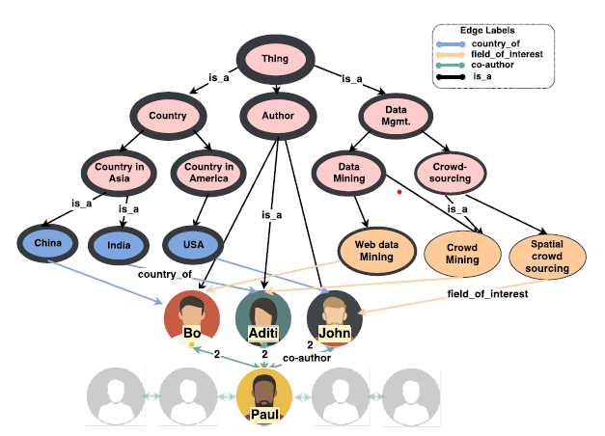
Related Work: SemSim 2019

Slide 5
Related Work: LSimRank
1. “The label information of a node u does not only depends on its own label, but also depends on the labels in its neighborhood”.
2. “Closer neighbors of u contribute more to the label information of u than farther neighbors”.

Slide 6
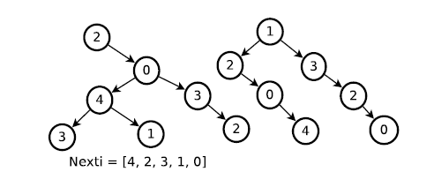
Related Work: READS

Slide 7
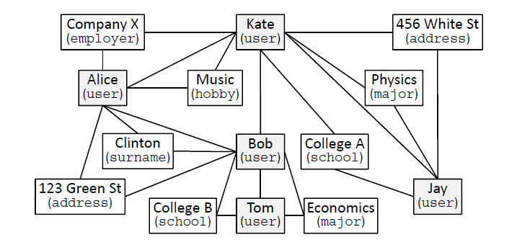
Related Work: Metagraph-based Learning

Slide 8
Motivation

Slide 9
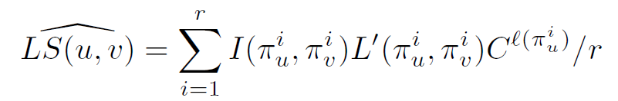


READS & LSimRank
To use the READS framework, the author of LSimRank simply store the whole SAForest for LSimRank computation.

Slide 10
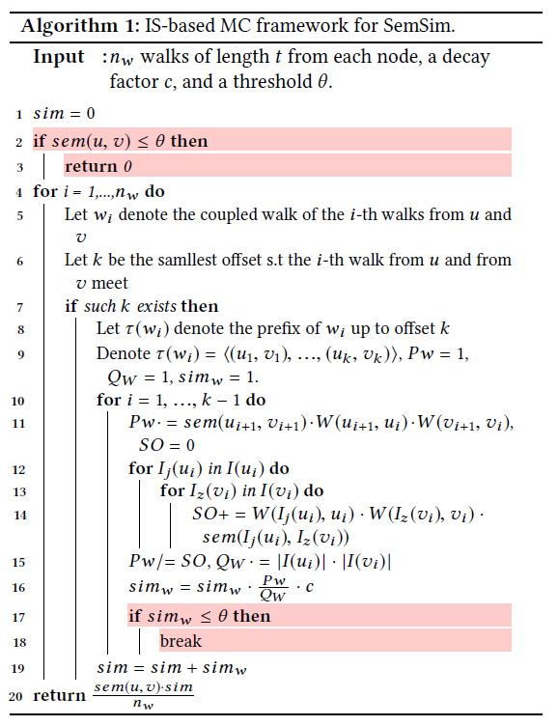
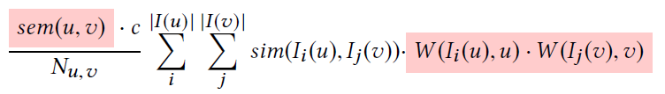
SemSim
Apply MC in online stage, slower query…

Slide 11
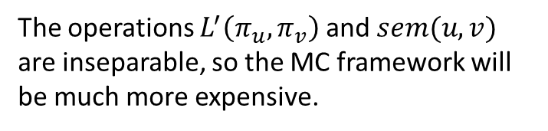
Problems
Inseparable Operations
The operations $L^{′}\left(π_{u}, π_{v}\right)$ and $sem(u, v)$ are inseparable, so the MC framework will be much more expensive.
But take a look at edge weight…

Slide 12
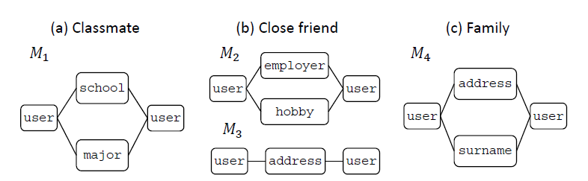
How to determine edge weight?
Metagraph-based Learning

Slide 13
Details

Slide 14




Offline: Training

Slide 15
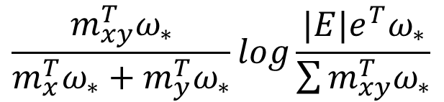
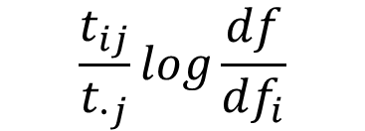
Edge Weight with TF-IDF
TF-IDF
$$\frac{t_{ij}}{t_{∙j}}log\frac{df}{df_{i}}$$
With learned feature extractor
$$\frac{{m_{xy}^{T}ω}_{∗}}{m_{x}^{T}ω_{∗}+m_{y}^{T}ω_{∗}}log\frac{|E|e^{T}ω_{∗}}{\sum{{m_{xy}^{T}ω}_{∗}}}$$

Slide 16


Offline: READS indexing
Insert learned weights
$$\operatorname{Pr}\left(u_{i+1}=v\right)∝\frac{\sqrt{c}}{\left|In\left(u_{i}\right)\right|}W(u_{i},v)$$

Slide 17
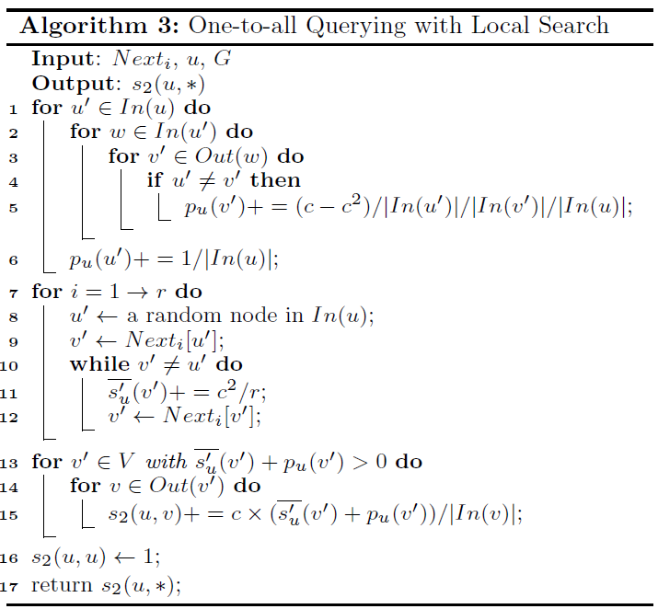
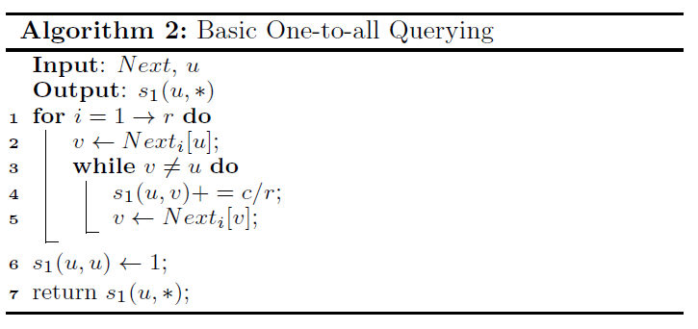

Online querying example: One-to-all
We could apply simple pruning to further optimize the performance
With local search, we could prove better bound using Hoeffding’s inequality.

Slide 18
Analysis

Slide 19

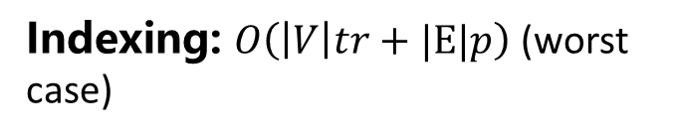
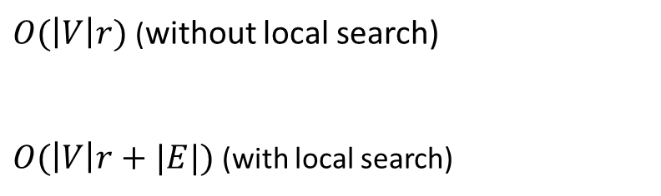
Time complexity
Storage
Indexing: $O\left(\left|V\right|tr+|E|p\right)$ (worst case)
$O(\left|V\right|r)$ (without local search)
$O(\left|V\right|r+|E|)$ (with local search)
Querying: $O(\left|V\right|r)$ (without local search)
$O(\left|V\right|r+|E|)$ (with local search)

Slide 20
References
[1] Fang, Y., Lin, W., Zheng, V. W., Wu, M., Chang, K. C.-C., & Li, X.-L. (2016). Semantic proximity search on graphs with metagraph-based learning. 2016 IEEE 32nd International Conference on Data Engineering (ICDE). doi:10.1109/icde.2016.7498247
[2] T Milo, A Somech, B Youngmann. Boosting simrank with semantics
. Proc. EDBT, 2019
[3] Yang Wu, Ada Wai-Chee Fu, Cheng Long, and Zitong Chen. LSimRank: Node Similarity in a Labeled Graph
[4] Jiang, M., Fu, A. W.-C., & Wong, R. C.-W. (2017). READS. Proceedings of the VLDB Endowment, 10(9), 937–948. doi:10.14778/3099622.3099625

Slide 21
THANK YOU

